Slide 1
MYCINE mobile
Personal movie library management & rental

Slide 2
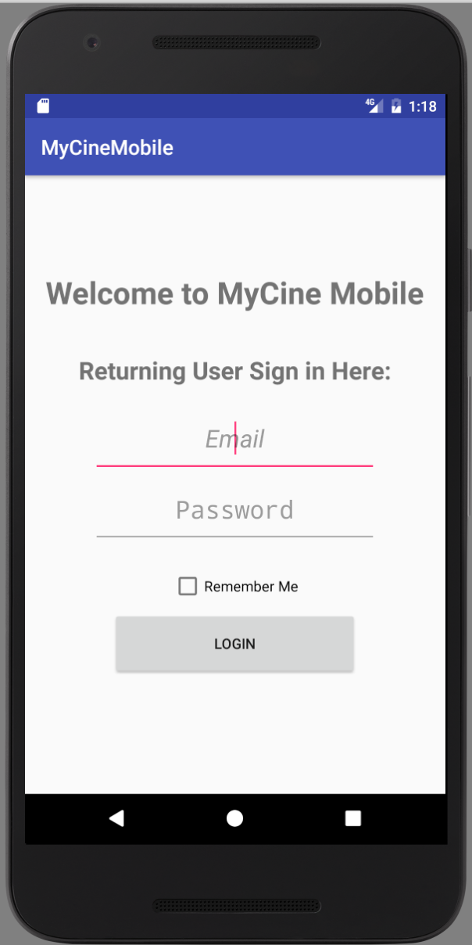
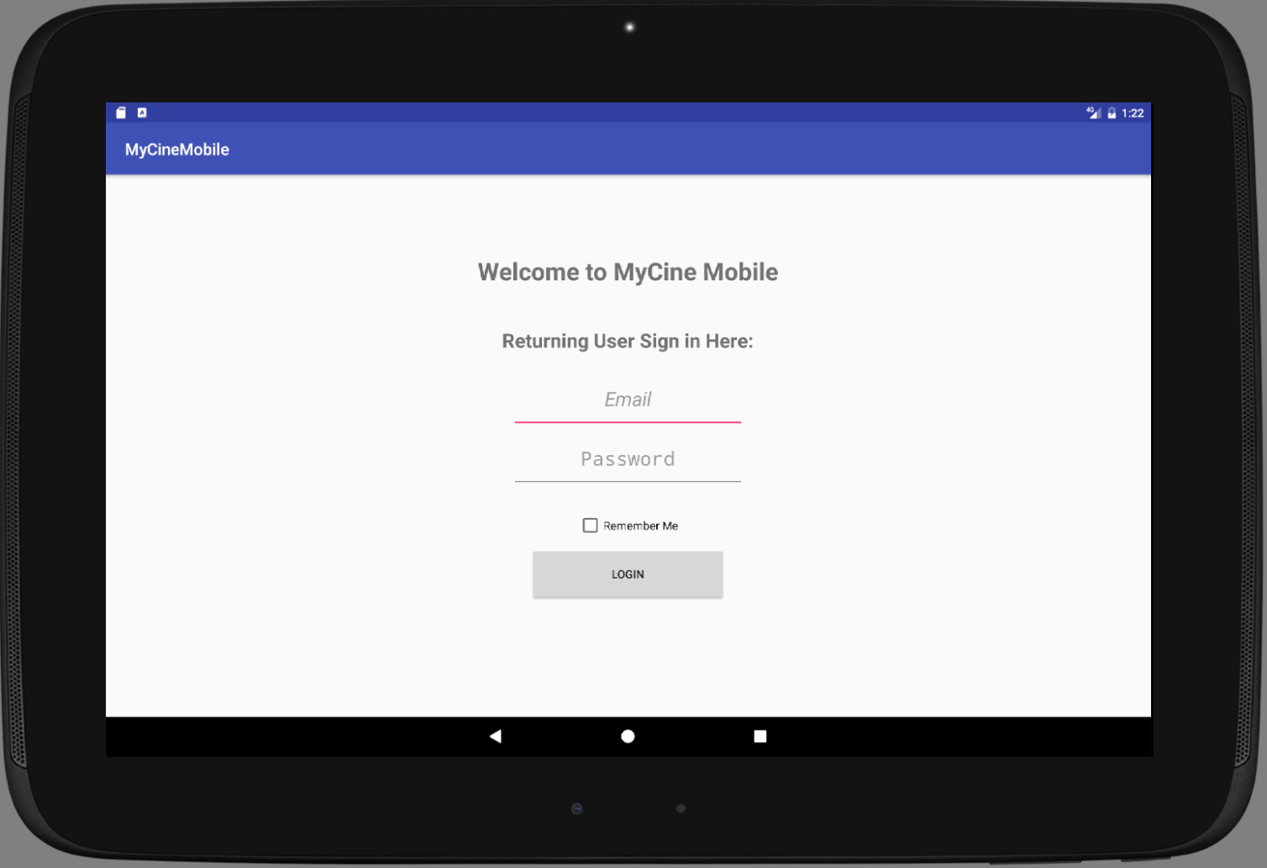
Login User signs in with Email & Password (option to remember username)

Slide 3
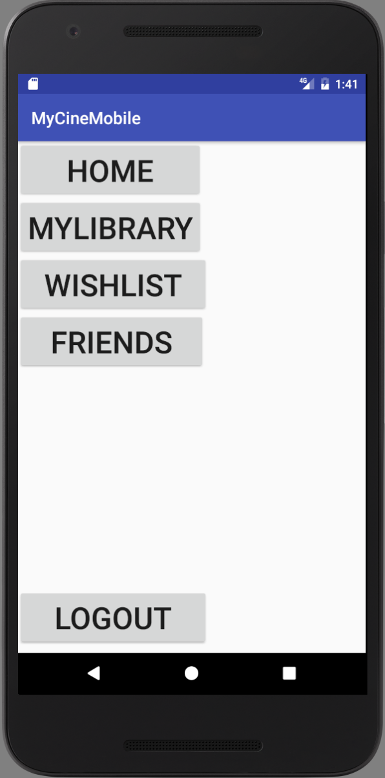
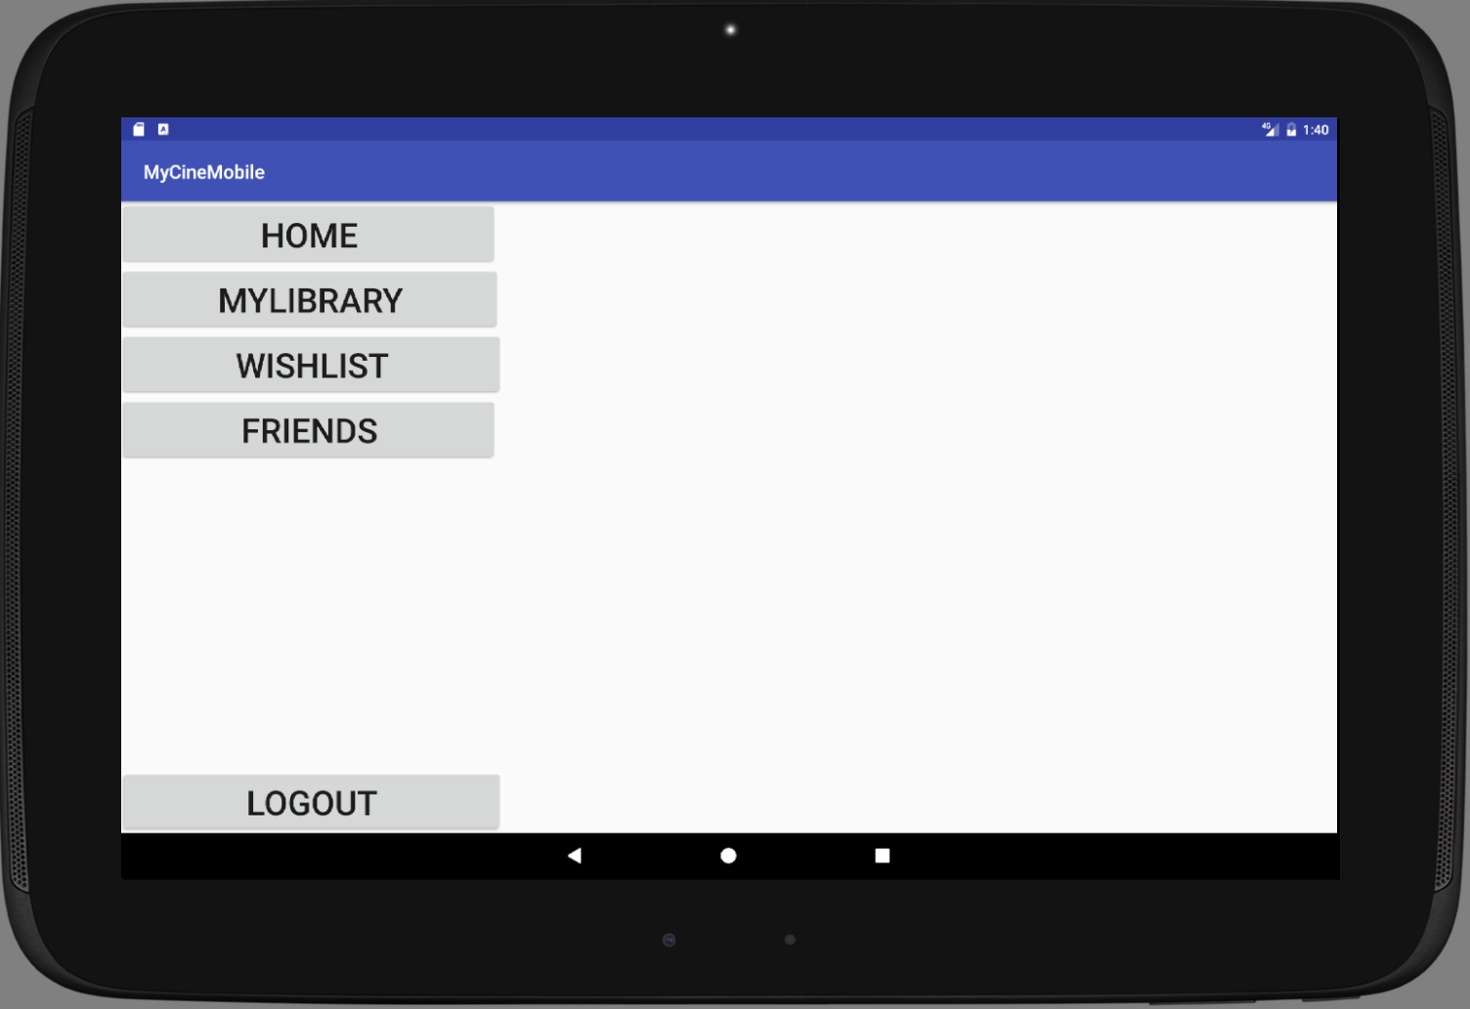
Application Drawer Houses navigation to the different modules (Activities)

Slide 4
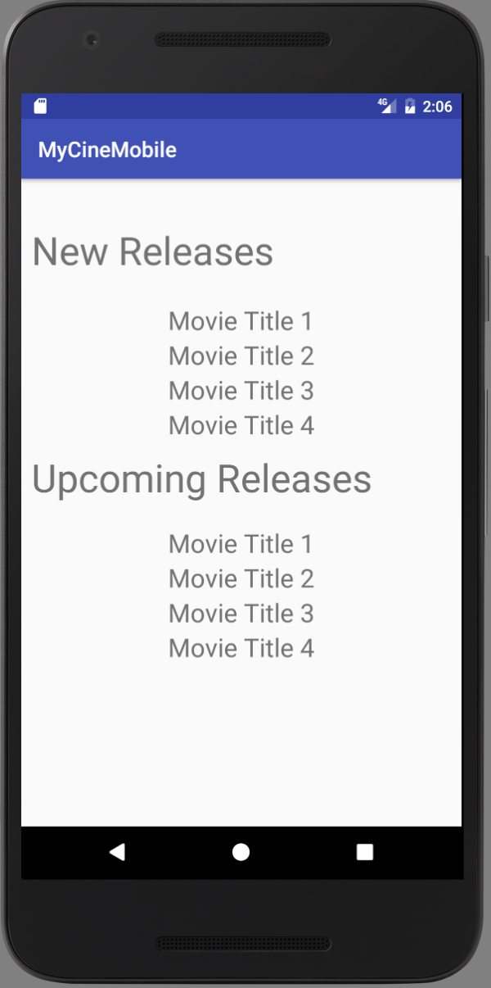
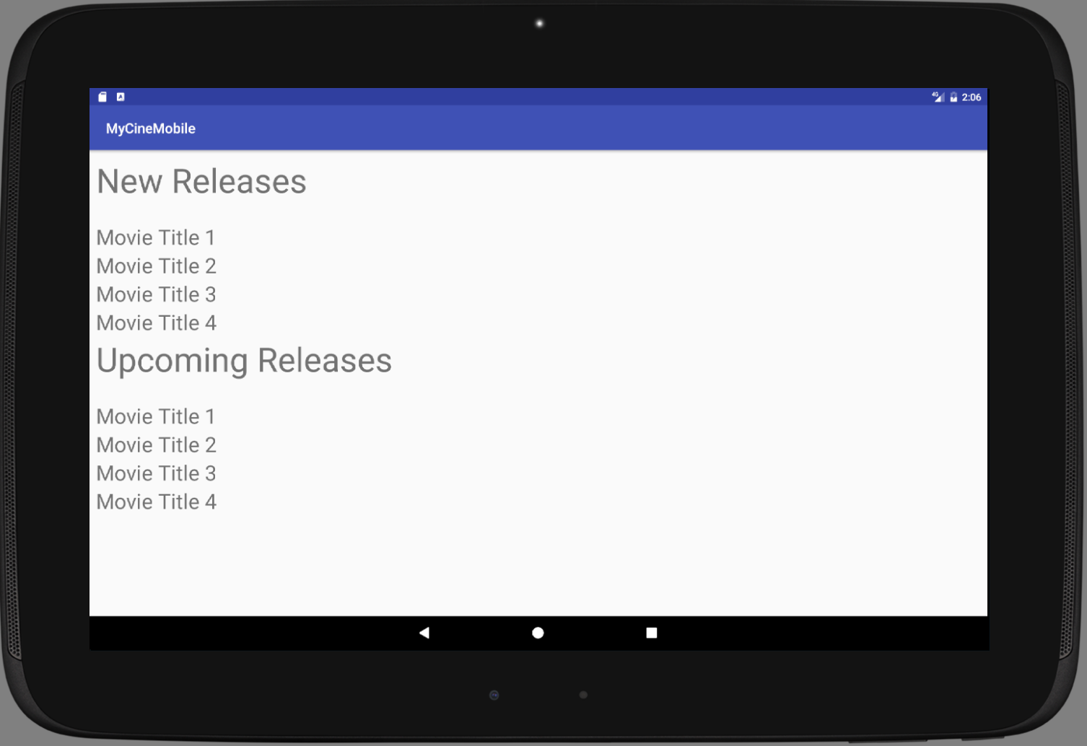
Home Displays New Releases (last 14) and upcoming releases (next 14)

Slide 5
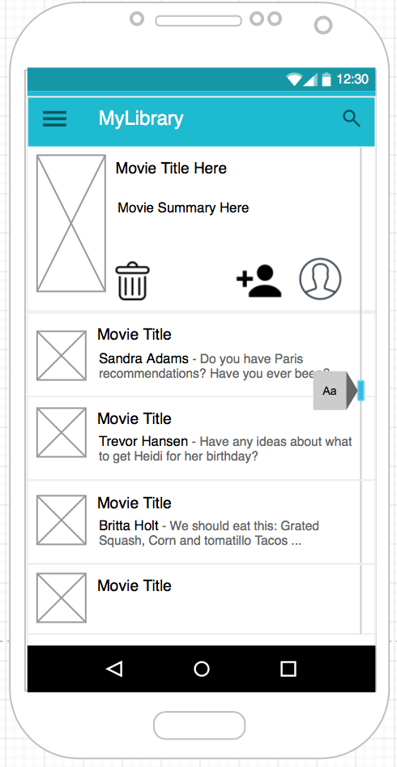
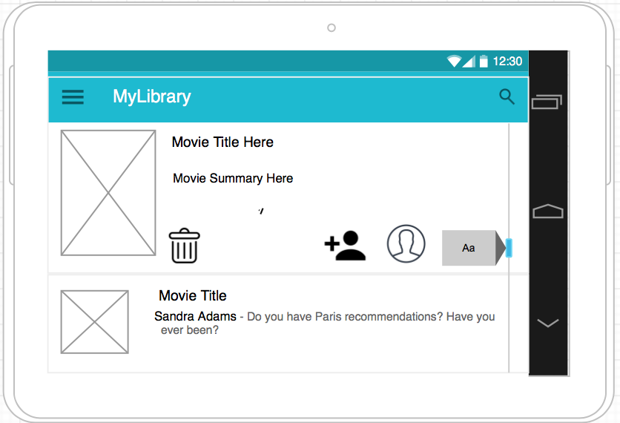
MyLibrary Displays titles currently in your library (ability to remove, or rent out) – User silhouette icon toggles + to rent, profile pic if rented

Slide 6
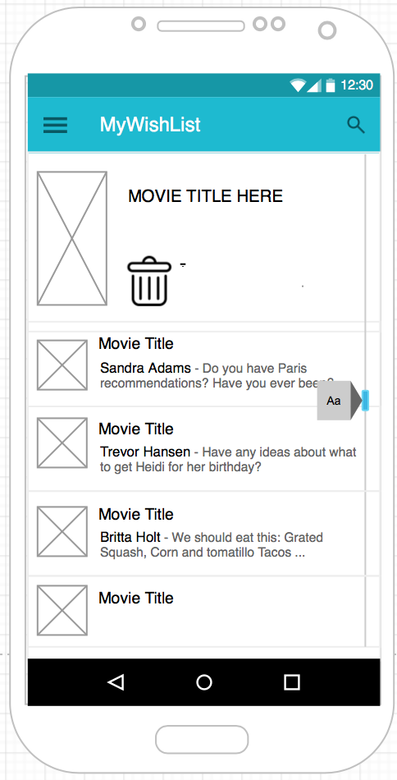
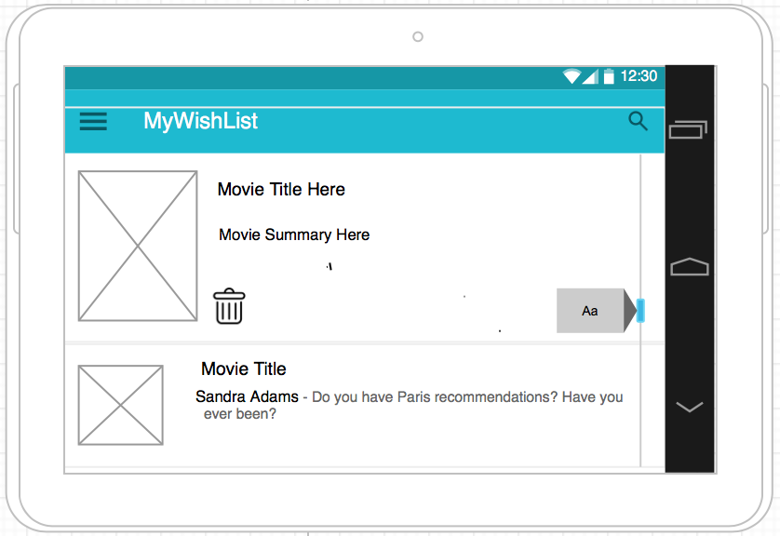
Mywishlist Same structure as mylibrary – shows titles you are watching/wishing for

Slide 7
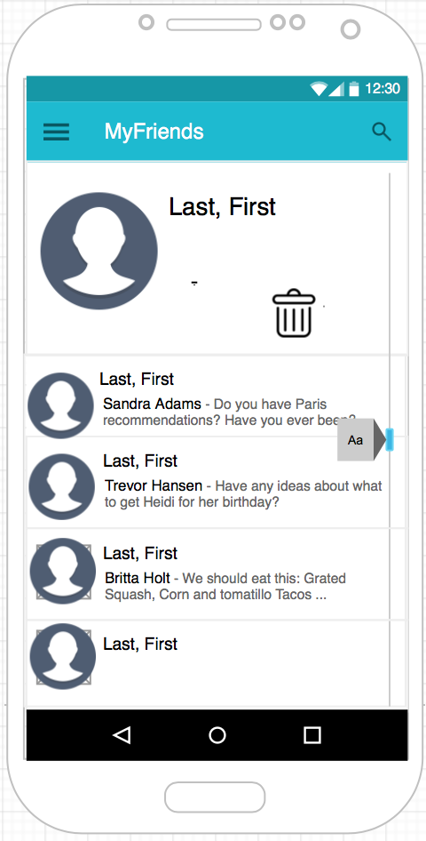
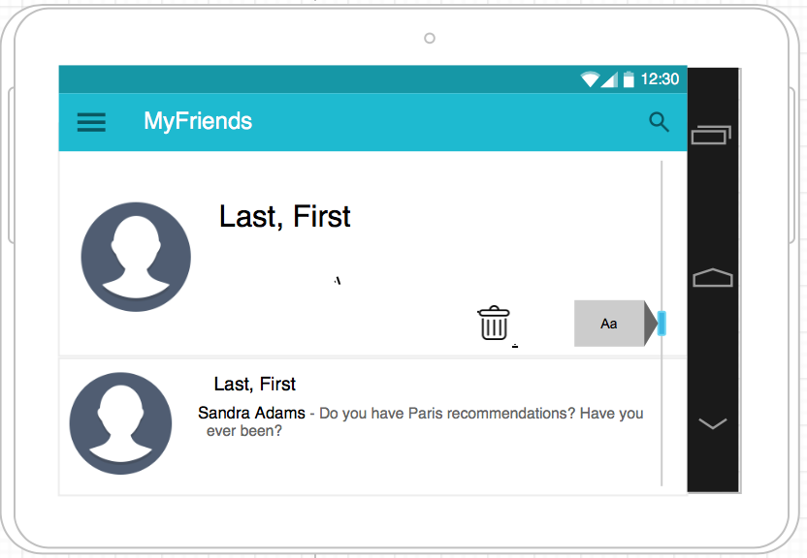
Myfriends Displays users whom are your friends (sharing libraries) – Friends can be rented to

Slide 8
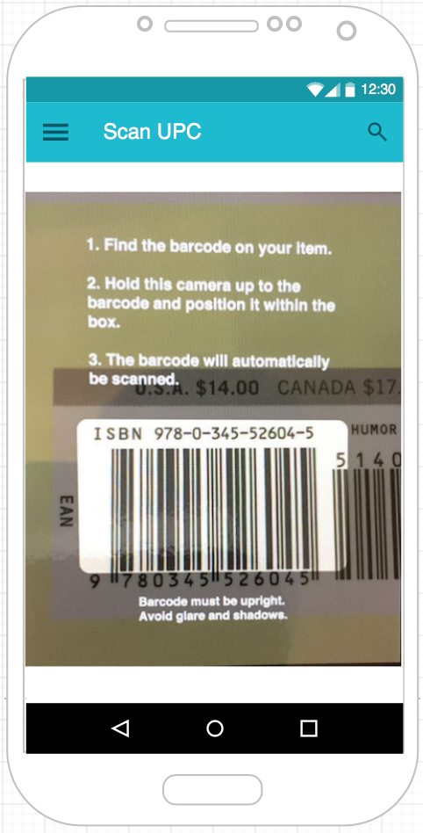
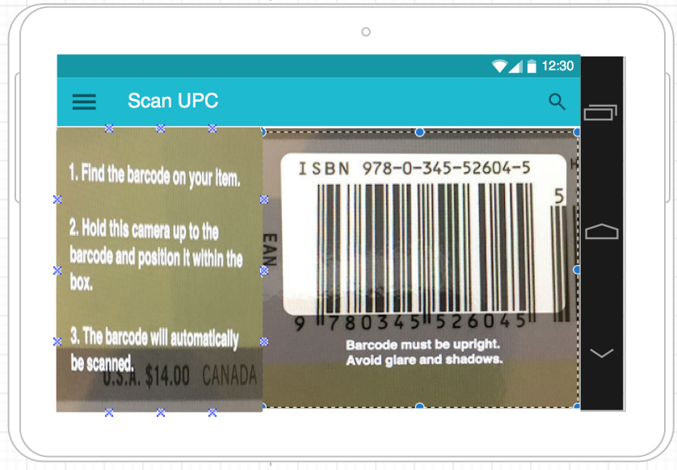
ScanUPC Using the camera and a barcode reader api search for movie information on imdb option to search libraries and add to mylibrary or wishlist

Slide 9
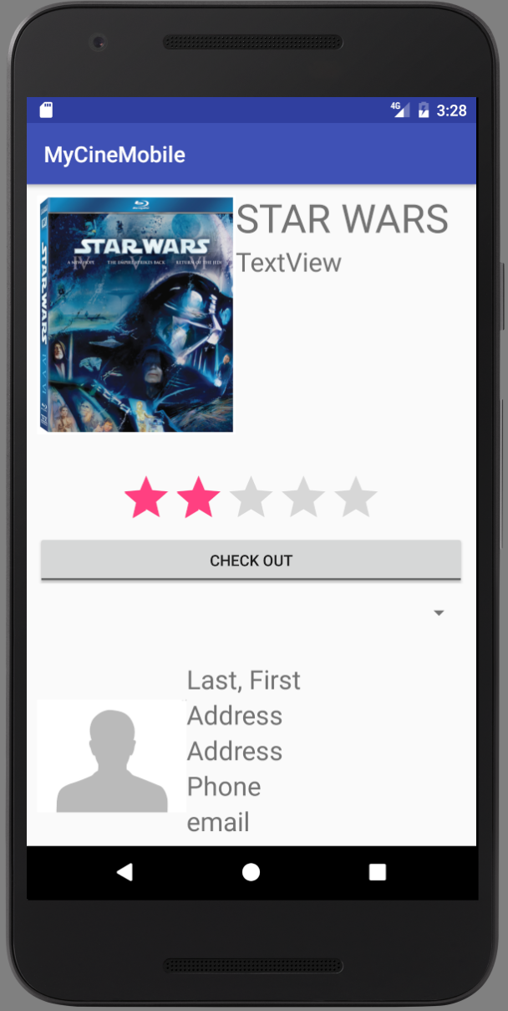
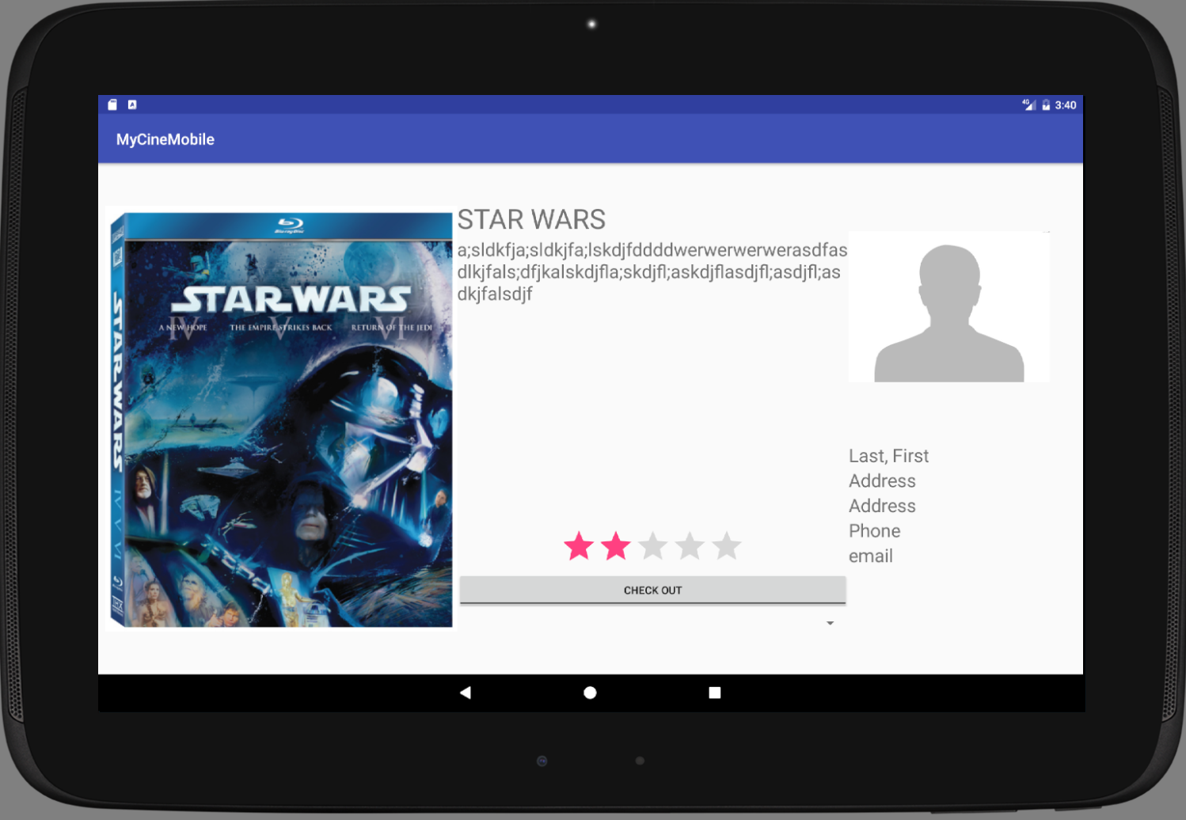
Title Details using api call to import movie data, display cover art. Allows rating titles and checkout. IF checked out will display friend data

Slide 10
Phase 1
Goal to complete physical (layout)
Login, Home Screen, MyLibrary, Wishlist & Friends
Create all Class/Fragment .java files
Wire up widgets / begin logic for user interactions (toggles etc)
Create test database and fill with testable data
Implement authentication/user information storage to device

Slide 11
Phase II
Goals
3rd Party API Calls (IMDB / myCine Web)
Implement barcode scan to search/add
Data storage to AWS hosted database
Add junit testing to validate code
Finish interaction logic (animation/toggles/etc)

Slide 12
Phase III
Goals
Make it PRETTY (if I can….)
Ensure all class files are commented w/ Javadoc
Wipe Test data from database – fill with POC data for presentation

